Slide 1
Understanding classical Lagrangian mechanics

Slide 2



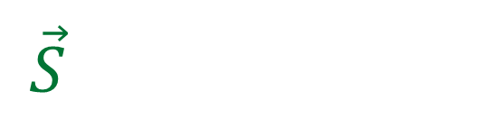


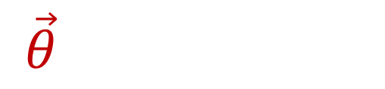



Hamilton’s principle of stationary action:
the line integral over $\vec{θ}$ is stationary on the trajectories
$\vec{S}=\left(\frac{dq}{dt},\frac{dp}{dt},\frac{dt}{dt}\right)$
$\vec{θ}=\left(p, 0, −H\right)$
$$L=\vec{θ}⋅\vec{S}$$
$δ𝒜\left[γ\right]=0$
$$q$$
$δ\int_{γ}{\vec{θ}⋅d\vec{γ}}=0$
$$γ :[q,p,t]\left(t\right)$$
$$t$$
$$p$$

Slide 3
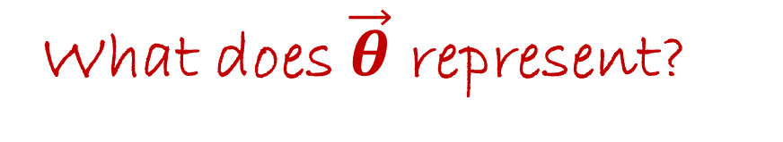
Hamilton’s principle of stationary action:
the line integral over $\vec{θ}$ is stationary on the trajectories
$\vec{S}=\left(\frac{dq}{dt},\frac{dp}{dt},\frac{dt}{dt}\right)$
$\vec{θ}=\left(p, 0, −H\right)$
$$L=\vec{θ}⋅\vec{S}$$
$δ𝒜\left[γ\right]=0$
$$q$$
$δ\int_{γ}{\vec{θ}⋅d\vec{γ}}=0$
$$γ :[q,p,t]\left(t\right)$$
What does $\vec{θ}$ represent?
$$t$$
$$p$$

Slide 4


Note that we are still in a 3 dimensional space. It’s just that our coordinates are $(q,p,t)$ instead of $(x,y,z)$. So we have available all our vector calculus operations.
To understand what $\vec{θ}=\left(p, 0, −H\right)$ is we calculate its curl.
$curl\left(−\vec{θ}\right)=\left(\frac{∂θ_{p}}{∂t}−\frac{∂θ_{t}}{∂p},\frac{∂θ_{t}}{∂q}−\frac{∂θ_{q}}{∂t},\frac{∂θ_{q}}{∂p}−\frac{∂θ_{p}}{∂q}\right)$
$=\left(\frac{∂0}{∂t}−\frac{∂\left(−H\right)}{∂p},\frac{∂\left(−H\right)}{∂q}−\frac{∂p}{∂t},\frac{∂p}{∂p}−\frac{∂0}{∂q}\right)=\left(\frac{∂H}{∂p},−\frac{∂H}{∂q}, 1\right)$

Slide 5


Now let’s compare the curl of $−\vec{θ}$ to $\vec{S}$.
$\vec{S}=\left(\frac{dq}{dt},\frac{dp}{dt},\frac{dt}{dt}\right) \left(\frac{∂H}{∂p},−\frac{∂H}{∂q}, 1\right)=curl\left(−\vec{θ}\right)$

Slide 6


Now let’s compare the curl of $−\vec{θ}$ to $\vec{S}$.
$\vec{S}=\left(\frac{dq}{dt},\frac{dp}{dt},\frac{dt}{dt}\right)=\left(\frac{∂H}{∂p},−\frac{∂H}{∂q}, 1\right)=curl\left(−\vec{θ}\right)$
These are the same because of Hamilton’s equations
$−\vec{θ}$ is the vector potential for $\vec{S}$

Slide 7



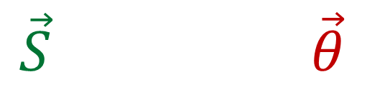

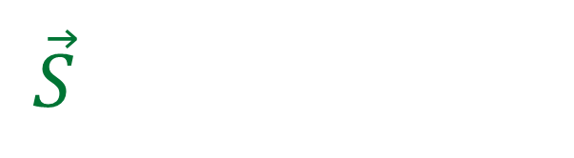

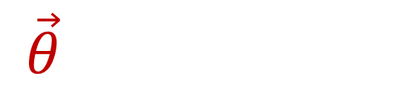

$\vec{S}=\left(\frac{dq}{dt},\frac{dp}{dt},\frac{dt}{dt}\right)$
$\vec{θ}=\left(p, 0, −H\right)$
Hamilton’s equations
$$\vec{S}=−curl(\vec{θ})$$
$$q$$
$$γ :[q,p,t]\left(t\right)$$
Hamilton’s principle
$L=\vec{θ}⋅\vec{S}$
$δ\int_{γ}{\vec{θ}⋅d\vec{γ}}=0$
$$t$$
$$p$$

Slide 8
$\vec{S}=\left(\frac{dq}{dt},\frac{dp}{dt},\frac{dt}{dt}\right)$
$\vec{θ}=\left(p, 0, −H\right)$
Hamilton’s equations
$$\vec{S}=−curl(\vec{θ})$$
$$q$$
$$γ :[q,p,t]\left(t\right)$$
Hamilton’s principle
$L=\vec{θ}⋅\vec{S}$
Why?
$δ\int_{γ}{\vec{θ}⋅d\vec{γ}}=0$
$$t$$
$$p$$

Slide 9
$\vec{S}=\left(\frac{dq}{dt},\frac{dp}{dt},\frac{dt}{dt}\right)$
$\vec{θ}=\left(p, 0, −H\right)$
Hamilton’s equations
$$\vec{S}=−curl(\vec{θ})$$
We want to show that Hamilton’s principle is just a consequence of Hamilton’s equations
Hamilton’s principle
$L=\vec{θ}⋅\vec{S}$
$δ\int_{γ}{\vec{θ}⋅d\vec{γ}}=0$

Slide 10

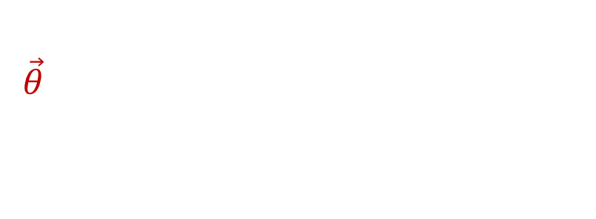





$δ\int_{γ}{\vec{θ}⋅d\vec{γ}}=\int_{γ}{\vec{θ}⋅d\vec{γ}}−\int_{γ′}{\vec{θ}⋅d\vec{γ}}$
$$q$$
The variation of the line integral of $\vec{θ}$ is the line integral over the original line $γ$ minus the line integral over the new line $γ^{′}$.
$$γ$$
$$γ′$$
$$t$$
$$p$$

Slide 11



$δ\int_{γ}{\vec{θ}⋅d\vec{γ}}=\int_{γ}{\vec{θ}⋅d\vec{γ}}−\int_{γ′}{\vec{θ}⋅d\vec{γ}}$
$=\int_{Σ}{curl\left(\vec{θ}\right)⋅d\vec{Σ}}$
$$q$$
Since $γ$ and $γ^{′}$ form a closed loop, the sum of their line integrals is equal to the surface integral of the curl.
$$γ$$
$$Σ$$
$$γ′$$
$$t$$
$$p$$

Slide 12

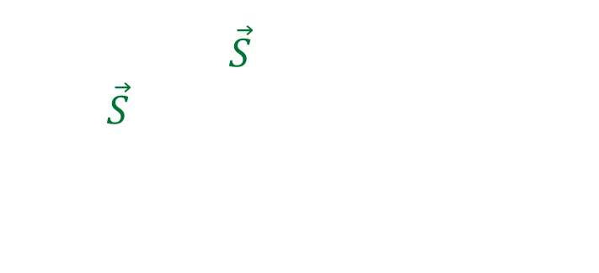
$δ\int_{γ}{\vec{θ}⋅d\vec{γ}}=\int_{γ}{\vec{θ}⋅d\vec{γ}}−\int_{γ′}{\vec{θ}⋅d\vec{γ}}$
$=\int_{Σ}{curl\left(\vec{θ}\right)⋅d\vec{Σ}}=0$
$$q$$
Recall that $\vec{S}$ is tangent to $γ$, and $\vec{S}=−curl(\vec{θ})$. Therefore $curl(\vec{θ})$ is tangent to $Σ$:
the surface integral is zero!
$$γ$$
$$Σ$$
$$γ′$$
$$t$$
$$p$$

Slide 13
$\vec{S}=\left(\frac{dq}{dt},\frac{dp}{dt},\frac{dt}{dt}\right)$
$\vec{θ}=\left(p, 0, −H\right)$
Hamilton’s equations
$$\vec{S}=−curl(\vec{θ})$$
$$q$$
$$γ :[q,p,t]\left(t\right)$$
Hamilton’s principle
Just a consequence of
Hamilton’s equations!
$L=\vec{θ}⋅\vec{S}$
$δ\int_{γ}{\vec{θ}⋅d\vec{γ}}=0$
$$t$$
$$p$$

